Slide 1

An Autonomous Institute
Affiliated to VTU, Belagavi, Approved by AICTE, New Delhi,
Recognized by UGC with 2(f) & 12(B), Accredited by NBA & NAAC
DEPARTMENT OF ELECTRICAL AND ELECTRONICS ENGINEERING
1st REVIEW
5
SUBJECT NAME: ELECTRICAL AND ELECTRONICS MEASUREMENTS
LECTURE PRESENTATION MODULE – 5
Group Members:
1. Chetan C (1MJ19EE006)
2. Shruthi K (1MJ19EE032)
3. Sumanth M (1MJ20EE404)
4. Vinay KS (1MJ18EE039)
Guided By: Dr Suresh Rao

Slide 2
TITLE
Development And Implementation Of Cloud Platform For IoT Devices

Slide 3
Contents
Introduction
Literature review
Motivations
Objectives
Work done
Road Map
Reference

Slide 4
Literature Review
Author & Year | Title | Review | Advantages | Disadvantages
Luca Calderoni, Antonio Magnani and Dario Maio. 2019 | IoT Manager: a Case Study of the Design and Implementation of an Open Source IoT Platform | a full stack IoT platform relying on open source technologies. Their main aim was to provide security and tangible implementation of solution, along with a detailed description of design strategies at each level of the stack | It's a full stack IOT platform which governs the IoT manager Employing Http and Https protocol makes it even more secure. | They relay/ depend on open source technologies (blynk) and the companies do not tend to unveil the research and hidden details

Slide 5
Author & Year | Title | Review | Advantages | Disadvantages
Aayush Doshi, Deep Vakharia 2021 | Iot based Home Automation | use of Raspberry Pi instead of Arduino and PIR sensors which are more effective than normal IR sensors for home security. User reliable wireless connection. use of an LDR sensor for light intensity and IR sensor to detect human presence and control automatically. | Easy to use and saves unnecessary. Low cost compared to other automation and power consumption systems. Easy to implement. Has good processing power and can handle multiple functions at the same time. Uses reliable wireless connection. | Usage of Google firebase which is a real time database makes the project cost inefficient and data transfer when devices are offline is not possible.

Slide 6
Author & Year | Title | Review | Advantages | Disadvantages
Miguel Angel López Peña and Isabel Muñoz Fernández 2019 | SAT-IoT: An Architectural Model for a High-Performance Fog/Edge/Cloud IoT Platform | uses a new concepts for IoT architectures and a reference model that is being implemented in a new IoT Platform named SAT-IoT. It also integrates IoT Computing Topology Management i.e cloud, edge, devices and their wireless or wired links as part of the IoT Platforms. | The embedded applications can access to all internal services of the platform, and not only those exposed externally in the API Gateway. It takes advantage of the platform in terms of access to its internal services, application setup functions and/or automated deployment processes. | As edge cloud computing is utilised, It requires more storage capacity. Security challenges in edge computing is high due to huge amount of data. It only analyse the data. Cost of edge computing is very high. It requires advanced infrastructure

Slide 7
Author & Year | Title | Review | Advantages | Disadvantages
Sameer Alani, Sarmad Nozad Mahmood 2021 | IoT based implemented comparison analysis of two well-known network platforms for smart home automation | This research is purely based to compare the applicability and the cost limitation of NETPI and BLYNK network platforms. NETPI is almost similar to BLYNK except with a bit programming complication than BLYNK. BLYNK Framework, which can be configured easily by IOS or Android apps to control Arduino, Raspberry Pi and the other microcontrollers that work over the internet. And NETPI framework can be the optimum choice to fulfill the specifications. | It gives complete design and implementation of an innovative, efficient, and low-cost smart house system. This research project compare the applicability and the cost limitation of NETPI and BLYNK network platforms | Restrictions to design with respect to GUI and usage of Blynk (open source).

Slide 8
Author & Year | Title | Review | Advantages | Disadvantages
Tanvi G Pareek, Raksha Padaki, Anuradha Iyer and Priya G 2022 | APP BASED DEVICE CONTROLLING SYSTEM | This paper focuses on Controlling the intensity of the LED via the slider on the app. Controlling Speed of the fan depending on the room’s temperature. And Storage of data onto Blynk Server, analysis of the results and representation in the form of a graph. | Prevent high expenditure on electricity, and make our campus more environment friendly and energy efficient. The connection via Wi-Fi makes things much more beneficial as we can control the appliances from a great distance too. | Usage of Blynk's server for storage of data and analysis making it unsecured and delay occurs

Slide 9
Introduction
IoT platforms are the support software that connects everything in an IoT system. An IoT platform facilitates communication, data flow, device management, and the functionality of applications.

Slide 10
Motivation
The possible drawbacks of this rapid evolution is the uncontrolled proliferation of heterogenous sensor network lacking interoperability features, even when they are deployed within the same context.
In order to improve the performance of an IoT system, the cloud Computing model aims to process the massive data generated from different IoT devices.
Only the processing results are transmitted to the cloud infrastructure or to the IoT devices, reducing the bandwidth consumption, the response latency and/or the storage needed.

Slide 11
Objective of work
To Develop and Implement a python powered cloud platform for IoT devices with following features:
Authentication
Authorization
Accessibility
Develop Web application for accessing the cloud
Interface between IOT device and cloud

Slide 12
Methodology
Database
Internet
IOT-Device
Server
Web App

Slide 13
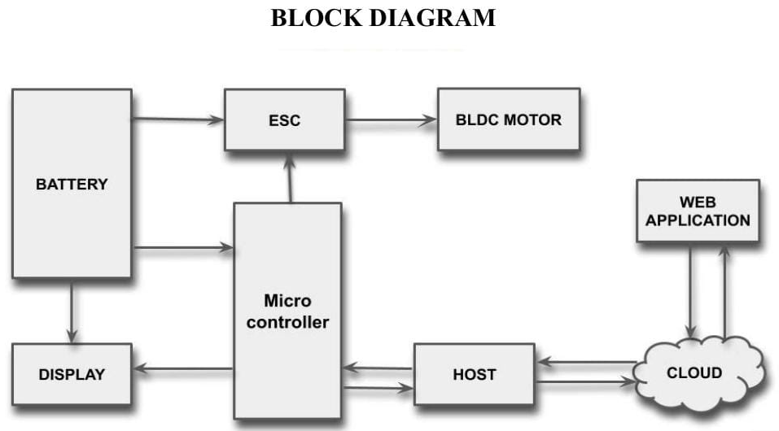

Slide 14
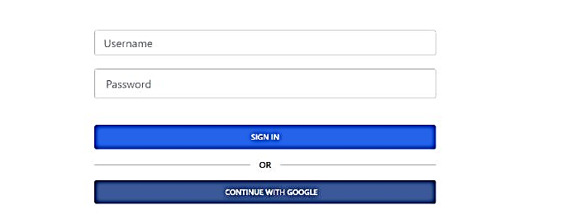
WORK DONE
Sign-in

Slide 15
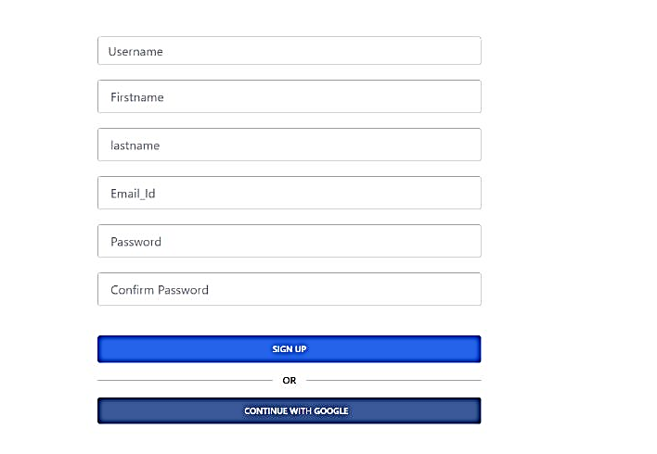
Sign-up

Slide 16
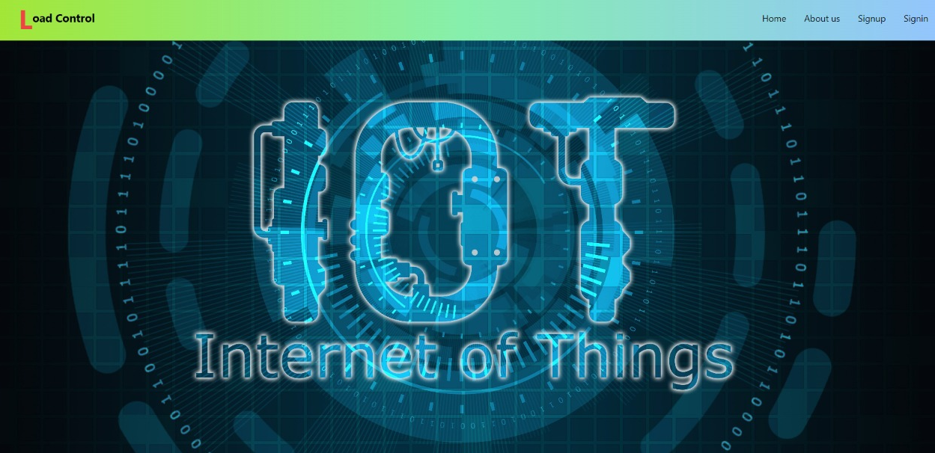
Home

Slide 17
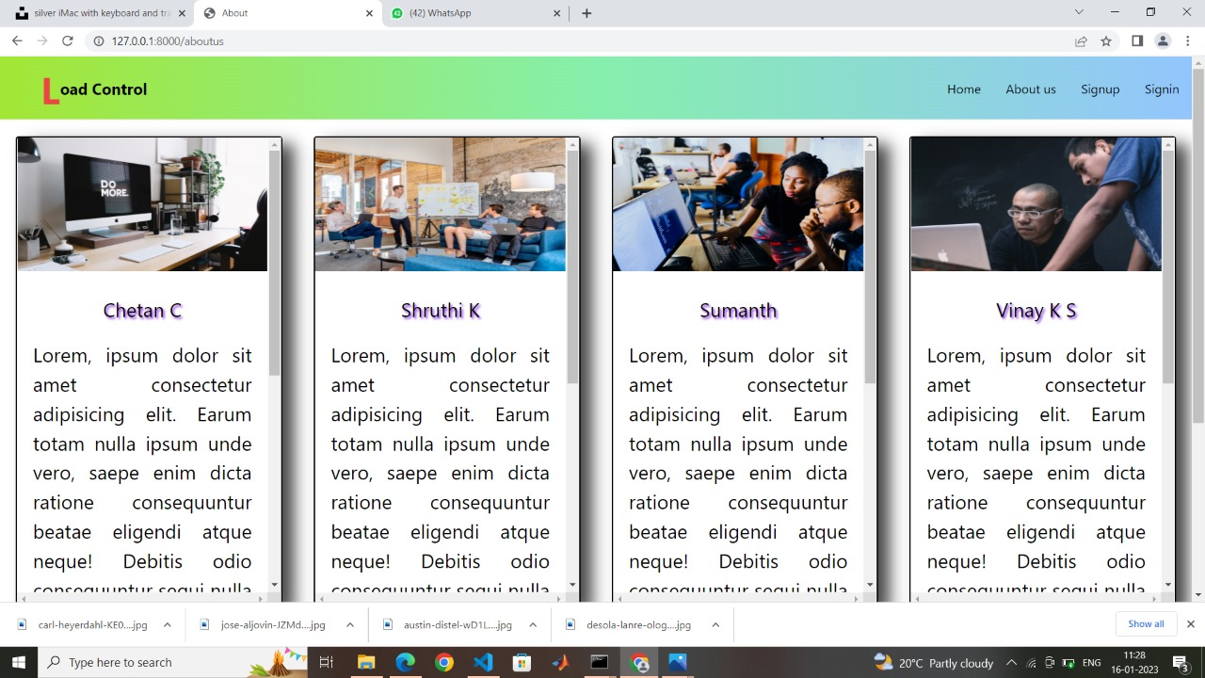
About us:

Slide 18
Detailed work plan
Sl. No. | Work to be Completed | Target Dates
1 | Literature Survey | 26/11/2022
2 | Selection of Front-End design | 30/11/2022
3 | Setting-up authentication | 01/12/2022
4 | Submission of 1st chapter report | 03/12/2022
5 | Completion of Front-End design | 12/12/2022
6 | Microcontroller programming | 19/12/2022
7 | Completion of server-side programming | 24/12/2022
8 | Debugging and troubleshooting of errors | 26/12/2022
9 | Submission of 2nd chapter report | 28/12/2022

Slide 19
Sl. No. | Work to be Completed | Target Dates
10 | Integrating of hardware and software | 13/02/2023
11 | Trail and error analysis of the project | 27/02/2023
12 | Final test on the project | 31/02/2023
13 | Concluding the results | 10/04/2023
14 | Submission of Draft Conference paper | 25/04/2023
15 | Submission of final product | 27/04/2023
16 | Submission of final Conference paper | 29/04/2023
17 | Draft paper submission | 05/05/2023
18 | Final paper submission | 25/05/2023

Slide 20
MVJ College of Engineering
Near ITPB, Whitefield
Bangalore-560 067
Thank You

